Slide 1
Concurrency
(or how to make burgers)

Slide 2

Once upon a time,
In a world without computers…

Slide 3



Slide 4


Slide 5





+
+
+
+
=

Slide 6
+
+
+
+
Well… Not really:
Gather ingredients (different for each recipe)
Prepare ingredients:
Slice (some) ingredients
Cook (some) ingredients
Stack ingredients (in correct order)
Deliver
=

Slide 7

+
+
+
+
Well… Not really:
Gather ingredients (different for each recipe)
Prepare ingredients:
Slice (some) ingredients
Cook (some) ingredients
Stack ingredients (in correct order)
Deliver
=

Slide 8
The Perfect Plan

Slide 9


Slide 11


Slide 12



Slide 13
Chapter 1: Single threaded burgers

Slide 14
Chapter 1: Single threaded burgers
The story of a single burger

Slide 15


Chapter 1: Single threaded burgers

Slide 16


Chapter 1: Single threaded burgers

Slide 17

Chapter 1: Single threaded burgers

Slide 18
Chapter 1: Single threaded burgers

Slide 19

Chapter 1: Single threaded burgers

Slide 20
Chapter 1: Single threaded burgers
Receive Order

Slide 21
Chapter 1: Single threaded burgers
2. Prepare ingredients

Slide 22
Chapter 1: Single threaded burgers
3. Cook (some) ingredients

Slide 23
Chapter 1: Single threaded burgers
4. Stack burger

Slide 24
Chapter 1: Single threaded burgers
5. Collect

Slide 25
Chapter 1: Single threaded burgers

Slide 26
Chapter 1: Single threaded burgers
1 Multicore Shop,
Exponential Plaza,
Concurrent City,
01248

Slide 27
Chapter 1: Single threaded burgers
Day: 1
Load: 10%

Slide 28
Chapter 1: Single threaded burgers
Day: 2
Load: 20%

Slide 29

Chapter 1: Single threaded burgers
Day: 3
Load: 40%

Slide 30




Chapter 1: Single threaded burgers
Day: 4
Load: 80%

Slide 31




Chapter 1: Single threaded burgers
Day: 4
Load: 100%
Errors: 60%

Slide 32
Chapter 2: Multi-threaded burgers

Slide 33
Chapter 2: Multi-threaded burgers

Slide 34

Chapter 2: Multi-threaded burgers

Slide 35
Chapter 2: Multi-threaded burgers
Day: 1
Load: 20%
Errors: 100%

Slide 36
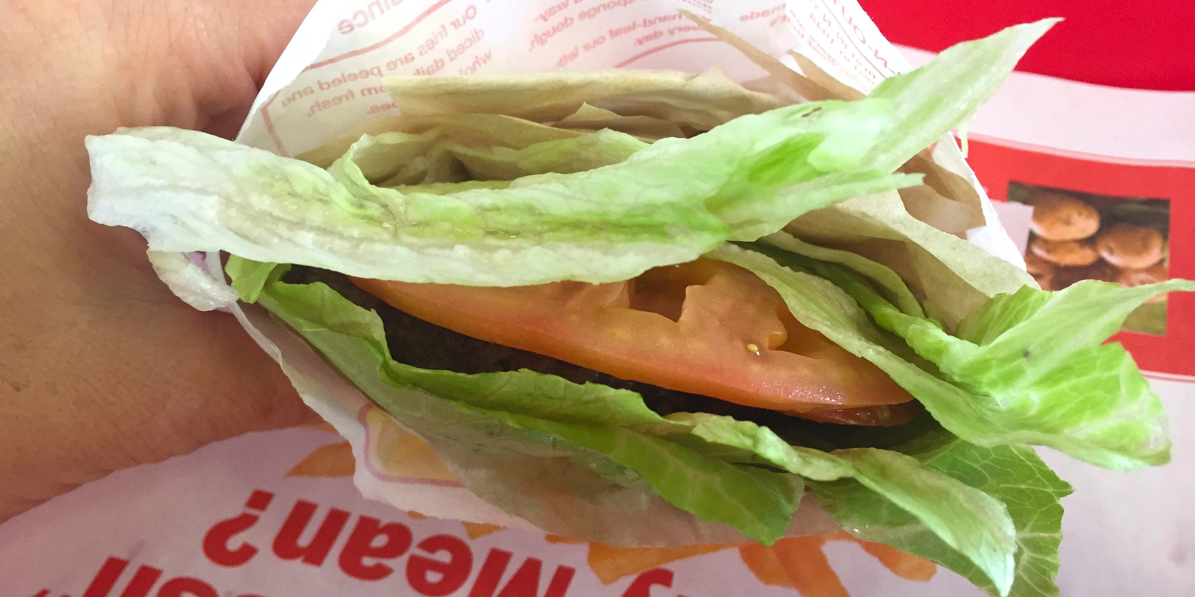
Chapter 2: Multi-threaded burgers
Day: 1
Load: 20%
Errors: 100%

Slide 37
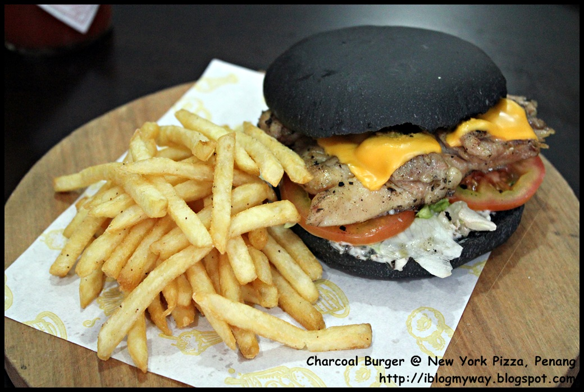
Chapter 2: Multi-threaded burgers
Day: 1
Load: 20%
Errors: 100%

Slide 38

Chapter 2: Multi-threaded burgers

Slide 39

Chapter 2: Multi-threaded burgers

Slide 40

Chapter 2.1: Multi-threaded burgers
(with Locks)

Slide 41
Chapter 2.1: Multi-threaded burgers
(with Locks)

Slide 42

Chapter 2.1: Multi-threaded burgers
(with Locks)

Slide 43
Chapter 2.1: Multi-threaded burgers
(with Locks)

Slide 44
Chapter 2.1: Multi-threaded burgers
(with Locks)

Slide 45
Chapter 2.1: Multi-threaded burgers
(with Locks)

Slide 46
Chapter 2.1: Multi-threaded burgers
(with Locks)

Slide 47
Chapter 2.1: Multi-threaded burgers
(with Locks)
Day: 1
Load: 100%
Errors: 20%

Slide 48
Chapter 2.1: Multi-threaded burgers
(with Locks)
Multiple Locks → Single Threaded
Day: 1
Load: 100%
Errors: 20%

Slide 49
Chapter 3: Parallel burgers

Slide 50

Chapter 3: Parallel burgers
1 Multicore Shop,
Exponential Plaza,
Concurrent City,
01248

Slide 51
Chapter 3: Parallel burgers
1 Multicore Shop,
Exponential Plaza,
Concurrent City,
01248

Slide 52
Chapter 3: Parallel burgers

Slide 53
Chapter 3: Parallel burgers
0%
0%
0%
100%
0%
0%
0%
0%

Slide 54
Chapter 3: Parallel burgers

Slide 55
Chapter 3: Parallel burgers

Slide 56
Chapter 3: Parallel burgers

Slide 57
Chapter 3: Parallel burgers

Slide 58
Chapter 3: Parallel burgers

Slide 59
Chapter 3: Parallel burgers

Slide 60

Chapter 3: Parallel burgers

Slide 61
Chapter 3: Parallel burgers

Slide 62
Chapter 3: Parallel burgers

Slide 63
Chapter 3: Parallel burgers

Slide 64

Chapter 3: Parallel burgers

Slide 65

Chapter 3: Parallel burgers

Slide 66
Chapter 4: Actor-model burgers

Slide 67
Chapter 4: Actor-model burgers
Actor Model!

Slide 68

Chapter 4: Actor-model burgers

Slide 69
Chapter 4: Actor-model burgers

Slide 70
Chapter 4: Actor-model burgers

Slide 71

Chapter 4: Actor-model burgers
Actor

Slide 72

Chapter 4: Actor-model burgers
Actor

Slide 73

Chapter 4: Actor-model burgers
Actor

Slide 74
Chapter 4: Actor-model burgers

Slide 75
Chapter 4: Actor-model burgers

Slide 76
Chapter 4: Actor-model burgers

Slide 77
Chapter 4: Actor-model burgers
80%
10%
5%
3%
2%

Slide 78

Chapter 4: Actor-model burgers
80%
10%
5%
3%
2%

Slide 79
Chapter 4: Actor-model burgers
Erlang:
Ericson Reports
99.9999% uptime
(distributed systems)

Slide 80
Chapter 5: Async burgers

Slide 81

Chapter 5: Async burgers

Slide 82
Chapter 5: Async burgers

Slide 83

Chapter 5: Async burgers

Slide 84
Chapter 5: Async burgers

Slide 85

Chapter 5: Async burgers

Slide 86
Chapter 5: Async burgers

Slide 87

Chapter 5: Async burgers

Slide 88
Chapter 5: Async burgers

Slide 89
Chapter 5: Async burgers
Cooperative:
Well behaved tasks.
Non-Blocking
Async all the way:
Async implementations
Task runners…
Smart cancelable jobs

Slide 90
Chapter 5: Async burgers
Back in the day…

Slide 91

Chapter 5: Async burgers
Back in the day…

Slide 92


Chapter 5: Async burgers
Back in the day…

Slide 93
Chapter 5: Async burgers
But now:

Slide 94
Chapter 5: Async burgers
But now:

Slide 95
Chapter 5: Async burgers
But now:

Slide 96
Chapter 5: Async burgers
But now:
await

Slide 97
Chapter 5: Async burgers
But now:
await

Slide 98
Chapter 5: Async burgers
But now:
await
await

Slide 99
Chapter 5: Async burgers
But now:
await
await
await

Slide 100
Chapter 5: Async burgers
But now:
await
await
await

Slide 101
Chapter 5: Async burgers
But now:
await == goto

Slide 102

Chapter 5: Async burgers
GoTo → Bad,
Functions → Good
But now:
await == goto
Edsger W. Dijkstra

Slide 103
Chapter 5: Async burgers
But now:

Slide 104

Chapter 5: Async burgers
But now:

Slide 105

Chapter 5: Async burgers
But now:

Slide 106
RxBurgers
RxBurgers
RxBurgers
RxBurgers
RxBurgers

